Slide 1

Project supervisor: Dr . Veena K Name of the student: VUNDAMATLA PRASANTHI Register no: 40731128
GARBAGE CLASSIFICATION USING IBM CLOUD

Slide 2
PRESENTATION OUTLINE
Course certificate
Introduction
Objectives
Ideation map
Module Implementation
Application snapshots
Result and discussion
Conclusion and future work
References

Slide 3
COURSE CERTIFICATE

Slide 4
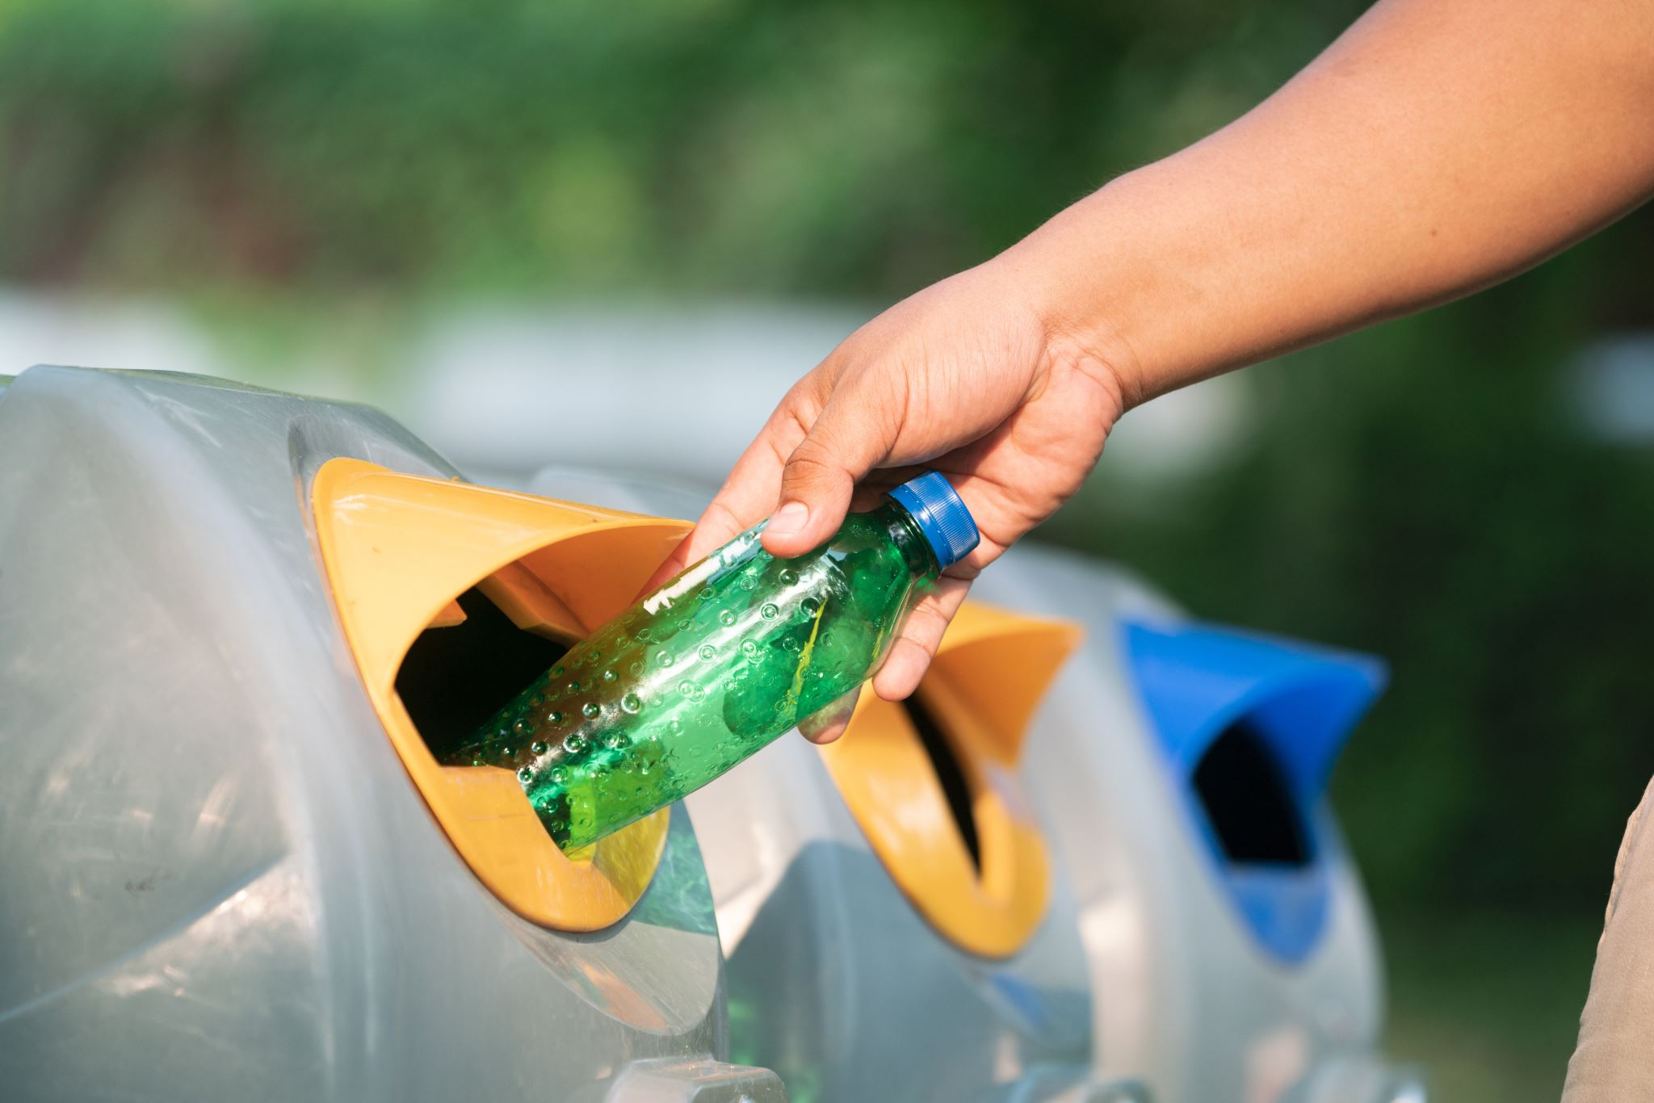
INTRODUCTION
Garbage classification is an important practice in waste management that involves the separation and categorization of waste materials into different categories like organic, hazardous among others. With the help of IBM cloud, it is now possible to transform the way we manage waste by utilizing advanced technologies such as Artificial Intelligence, Big data, and Internet of things(IoT) in the garbage classification process. The approach can help to reduce waste, conserve resources and protect the environment. IBM cloud provides various services including cognitive, blockchain, and analytics that can be integrated into the garbage classification systems to enable efficient and accurate sorting of garbage materials. By deploying such solutions, cities can optimize their waste management processes and reduce environmental damage caused by unsorted waste.

Slide 5
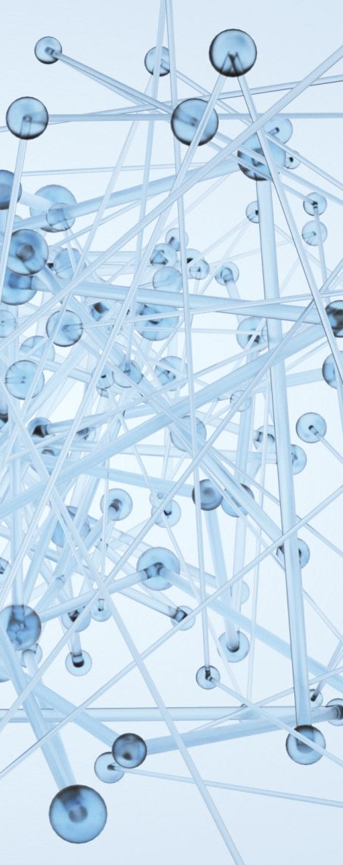
OBJECTIVES
Know fundamental concepts and techniques of Artificial Neural Networks and Convolutional neural networks.
Gain a broad understanding of image data
Work with sequential type of modelling.
Work with Keras capabilities
Work with image processing techniques
Know how to build a web application using the Flask framework.

Slide 6
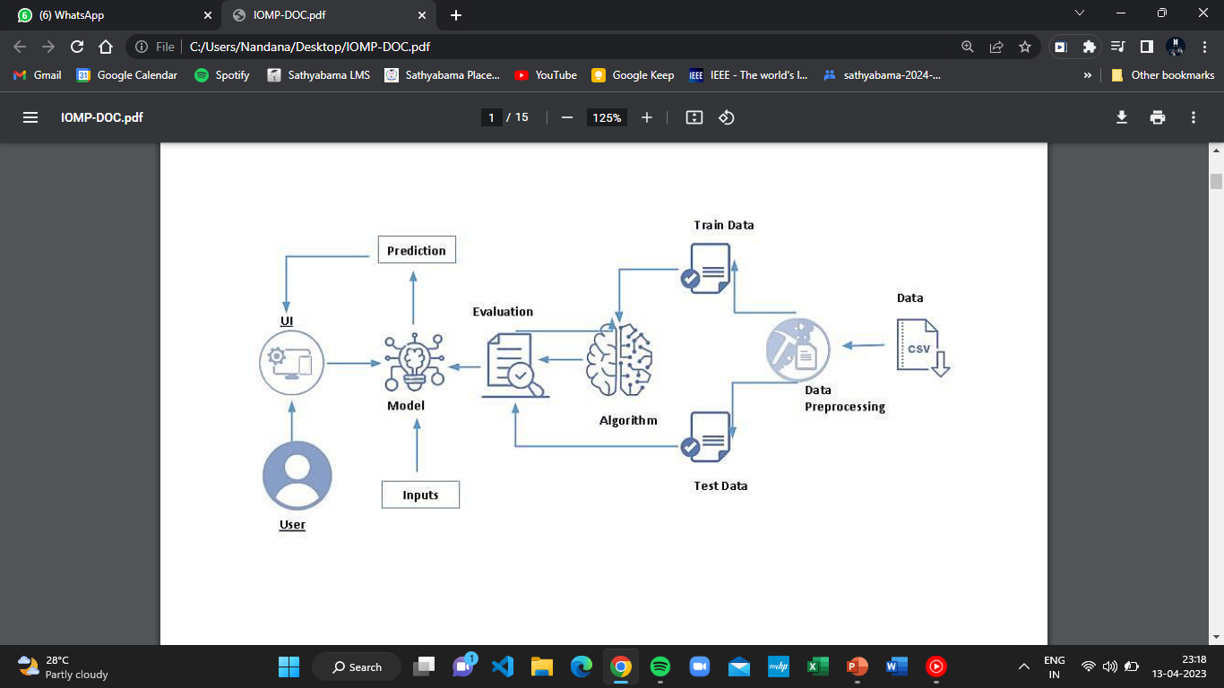
IDEATION MAP

Slide 7
EXISTING PROBLEM
Municipal solid waste (MSW) is hazardous to human health and the environment if not handled throughout all management processes, beginning with collection, separation, transfer, treatment, disposal or recycling and reuse. The World Health Organization(WHO) has raised awareness of the dangers of improper solid waste disposal in terms of improper solid waste disposal in terms of soil, water, and air pollution, as well as the health consequences for the people living in the surrounding areas. Inadequate waste management is one of the causes of the rise of infectious diseases. Most viruses, bacteria, and parasites that cause illness are found in blood, bodily fluids, and bodily secretions, which are components of bio-medical waste. This spreads through several human contacts, each of whom is a possible "receiver" of the illness. The Human Immunodeficiency Virus (HIV) and hepatitis viruses are at the forefront of a long list of illnesses and disorders that have been linked to biomedical waste. Other prevalent diseases spread owing to poor waste management include pneumonia, diarrhea, tetanus, whooping cough, and others.

Slide 8
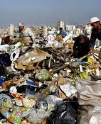
EXISTING SOLUTIONS FOR THE PROBLEM
When we speak about the existing solutions workers in garbage dumping areas are just facilitated with a Mask, Jacket ( Few areas), and, a pair of Gloves which is protecting the worker to some extend but anyhow it cannot be assured that human is fully protected and shielded. The present way of separating waste/garbage is the hand-picking method, whereby someone is employed to separate out the different objects/materials. The person, who separates waste, is prone to diseases due to the harmful substances in the garbage. With this in mind, it motivated to develop an automated system that can sort waste. Offering good salaries and few precautionary tools never brings a healthy life back and to solve this human must be replaced with a Intelligent machine.

Slide 9
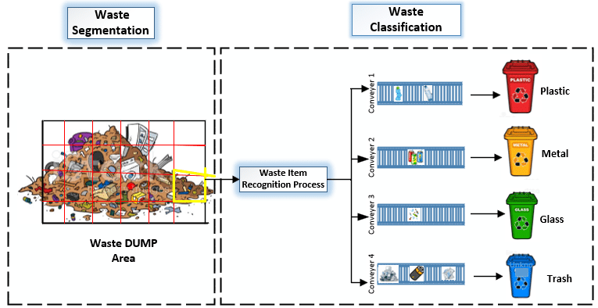
OUR PROPOSED SOLUTION
Aim is to design a intelligent human like machine which is capable of classifying garbage based on its previous training given by using multiple images of distinct garbage materials. The present way of separating waste/garbage is the hand-picking method, whereby someone is employed to separate out the different objects/materials. The person, who separates waste, is prone to diseases due to the harmful substances in the garbage. With this in mind, it motivated to develop an automated system that can sort waste. and this system can take short time to sort the waste, and it will be more accurate in sorting than the manual way. With the system in place, the beneficial separated waste can still be recycled and converted to energy and fuel for the growth of the economy. The system that is developed for the separation of the accumulated waste is based on the combination of Convolutional Neural Networks.

Slide 10
PROJECT FLOW
• User interacts with a user interface to upload the image.
• The uploaded image is analyzed by the model which is integrated.
• Once the model analyses the uploaded image, the prediction is showcased on the UI.
To accomplish this, we have to complete all the activities and tasks listed below:
• Data Collection
• Data Pre-processing
• Model Building
• Application Building

Slide 11
EXPERIMENTAL INVESTIGATIONS
One should have knowledge of the following Concepts:
• Supervised and unsupervised learning.
• Regression, Classification, and Clustering.
• Artificial Neural Networks.
• Convolation Neural Networks.
• Flask.

Slide 12
ADVANTAGES
✓ Human Involvement in the Garbage Classification process is reduced.
✓ Time taken in classification is very quick.
✓ Efficiency in the classification of garbage is also increased.
✓ Placing garbage for a long duration may result in increasing diseases and this is resolved.
DISADVANTAGES
People working in dump yards lose their job.
Error in classification may result in completely inconsistent results.
Continuous maintenance is required.
May be expensive for maintenance.

Slide 13
APPLICATIONS
Garbage classification has always been an important issue in environmental protection, resource recycling, and social livelihood. In order to improve the efficiency of front-end garbage collection, an automatic garbage classification system is proposed based on deep learning.
The model can be applied in all the garbage classification areas and this implementation will surely help us to classify the garbage efficiently.
We can save people working in garbage dump yards from deadly diseases and make the classification more advanced by using the proposed model.

Slide 14
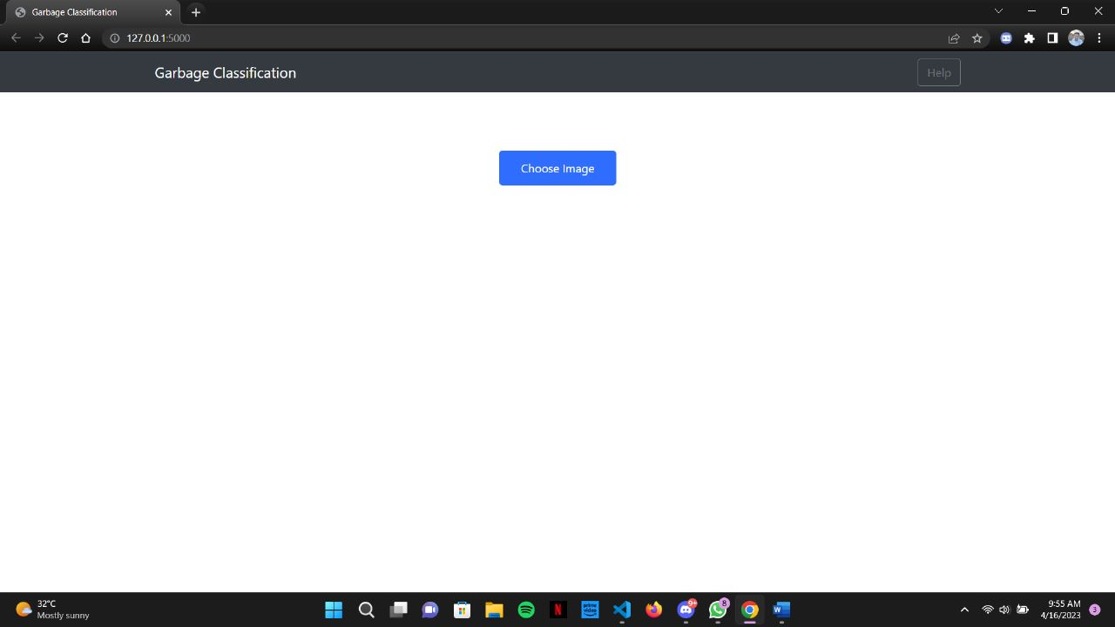
RESULT
HOME PAGE

Slide 15
CHOOSE IMAGE

Slide 16
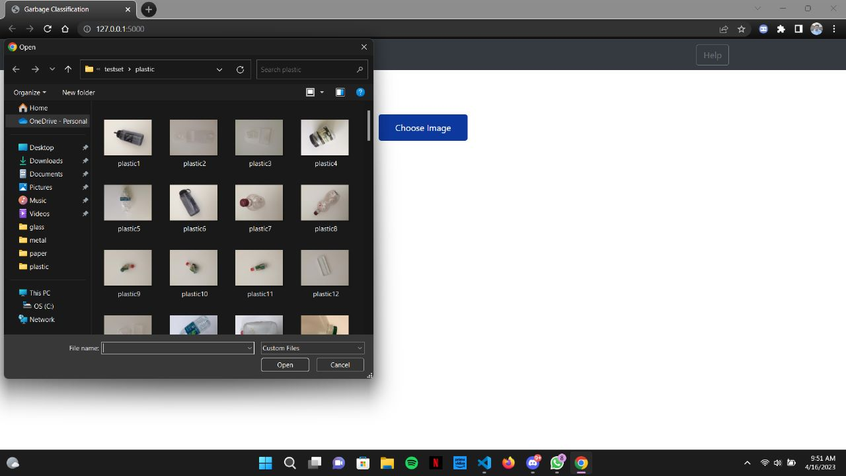
Choose Image (Trash/Waste))

Slide 17
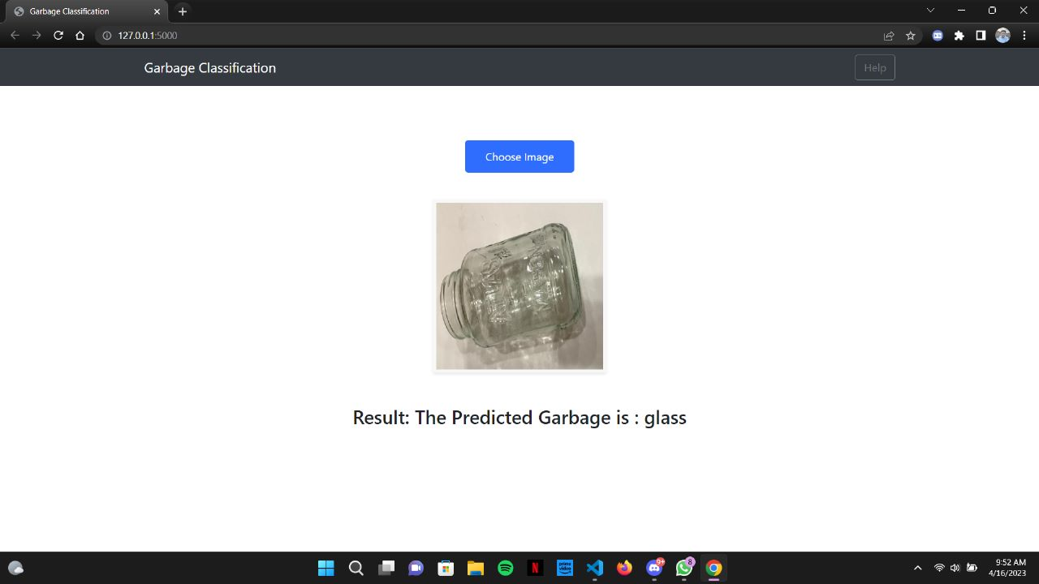
Machine Predicted Output

Slide 18
CONCLUSION
By using the model that we developed in this project we can classify the garbage based on its attributes and parameters and make the process of classification more efficient and robust.
A machine exposed to harmful garbage yards can be used efficiently as it is robust and has nothing to do with the harmful and toxic environment of dump yards.
Whereas if humans are exposed to a harmful and toxic environment will encounter multiple severe diseases in the long run and the healthy life of a human cannot be retrieved at any cost.
So we can conclude by saying that “Human life can’t be replaced but a machine can be replaced.”

